Slide 1

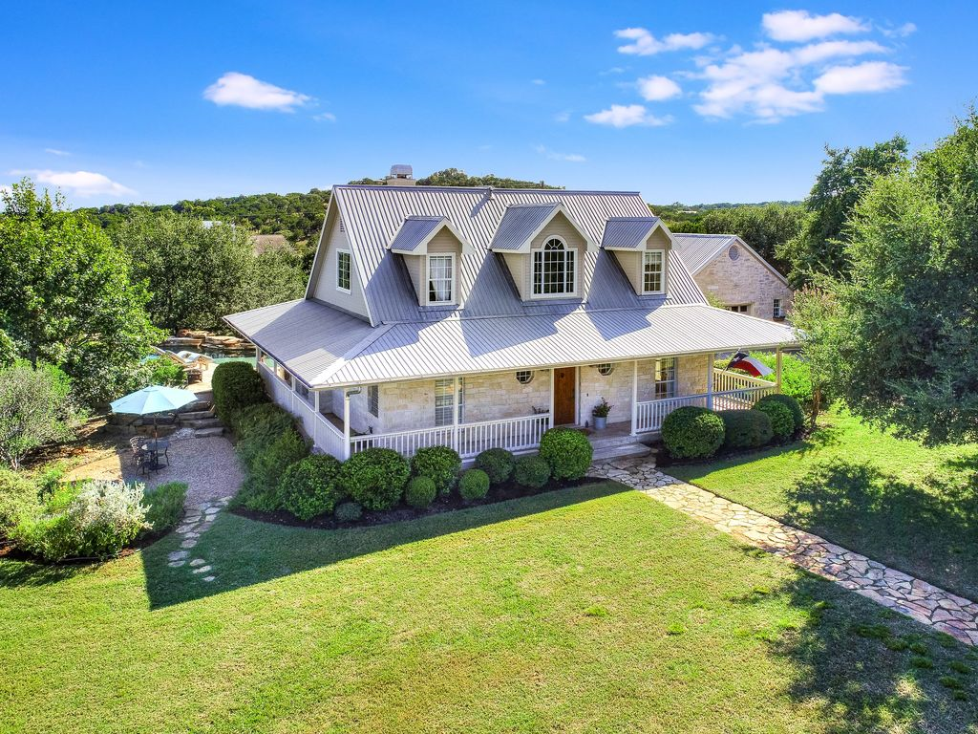
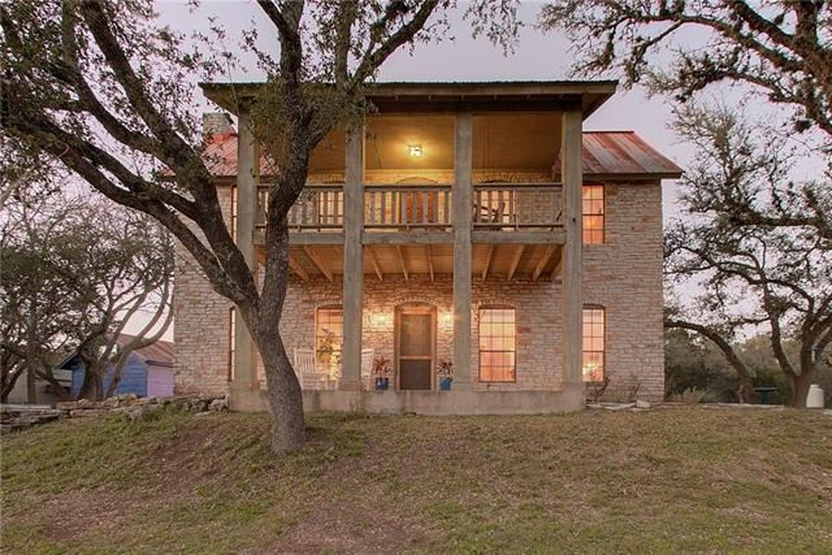

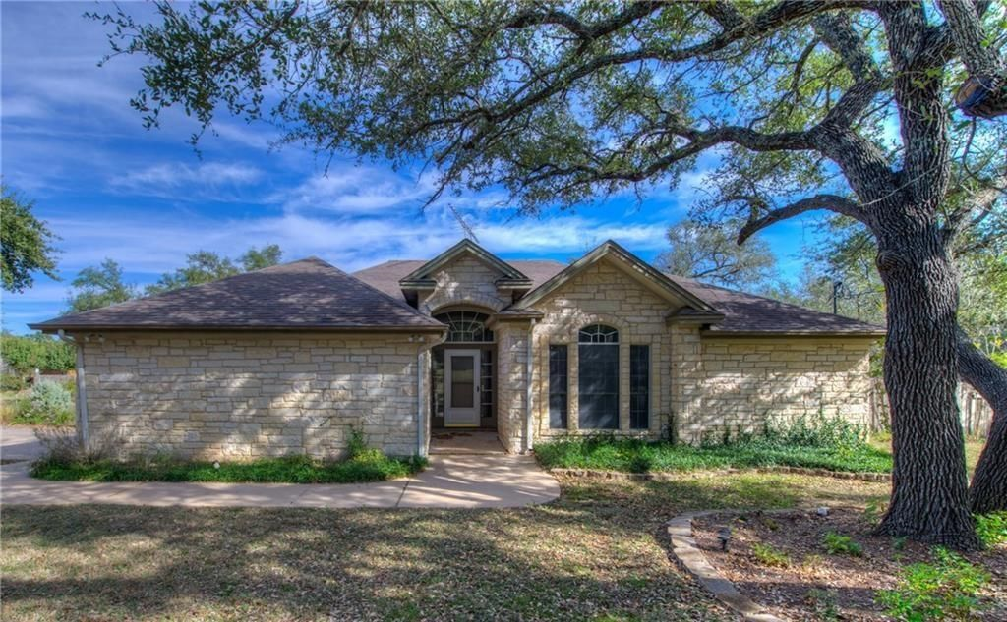
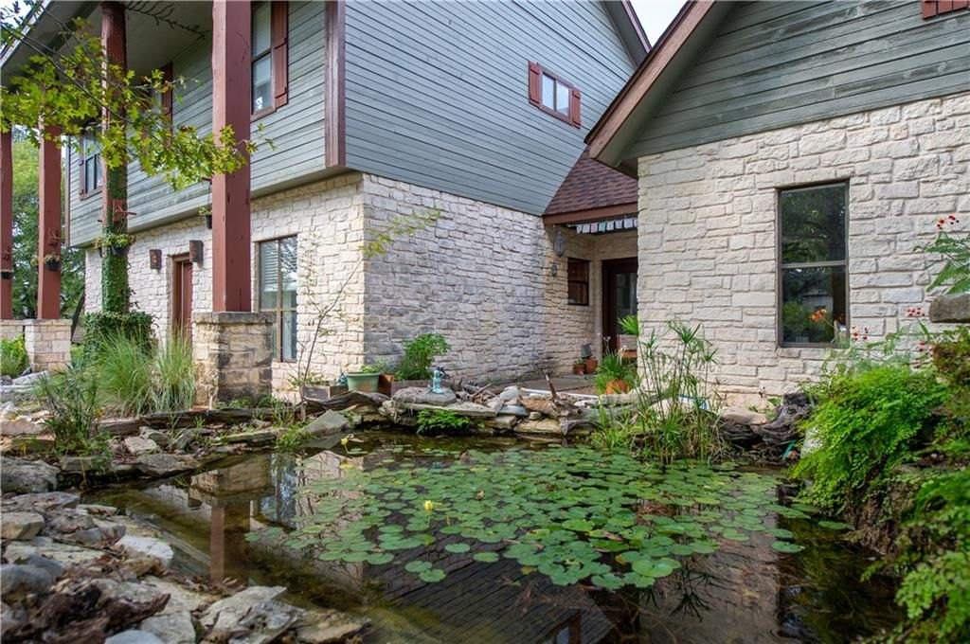

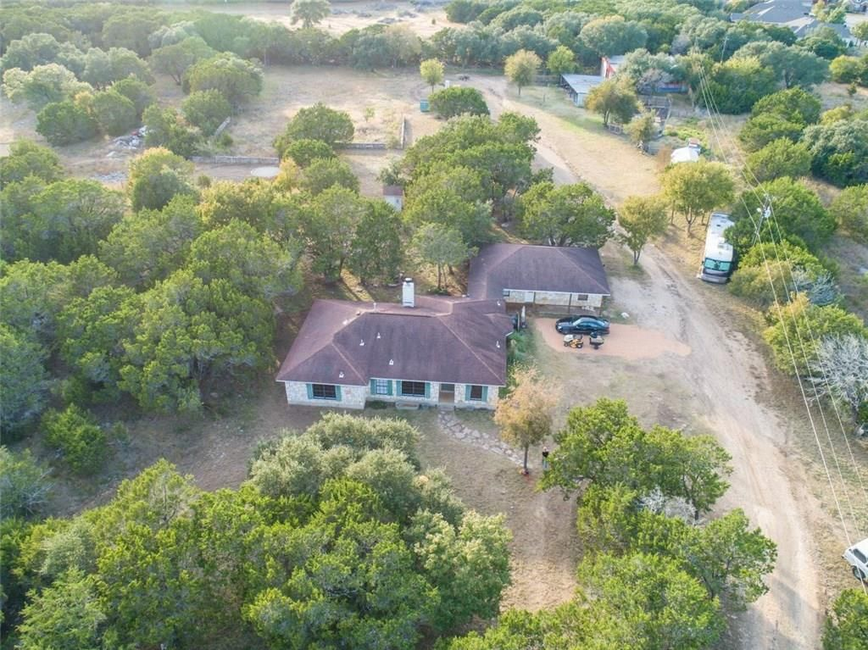




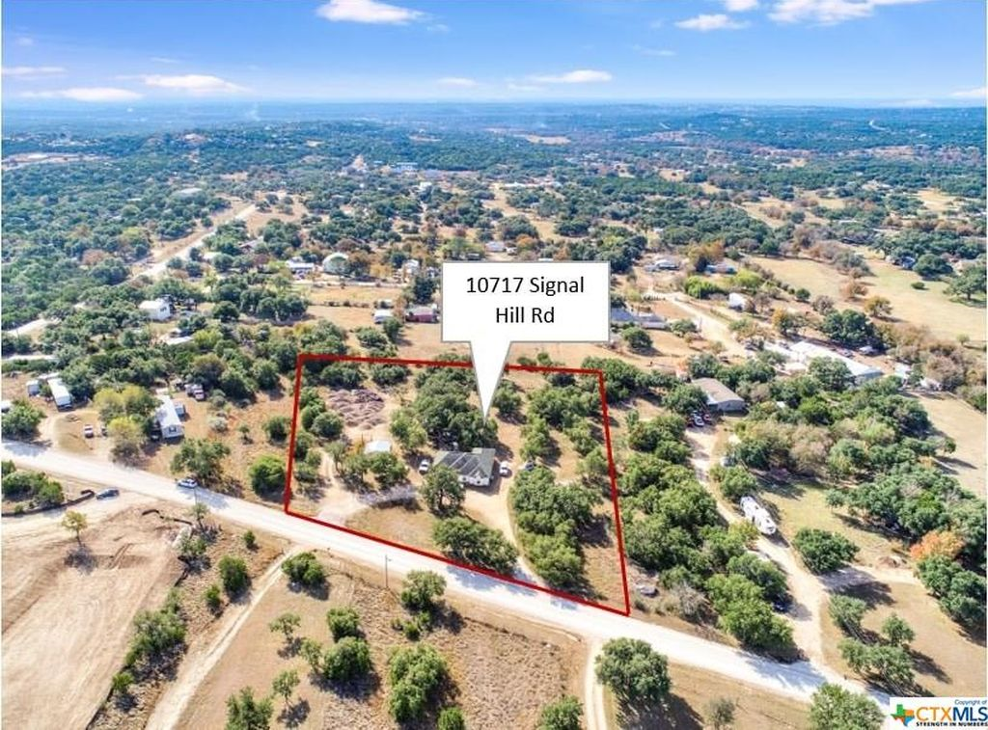
Austin, TX - House Listings
DATA ANALYSIS OF THE HOUSING MARKET
Prepared by: Nina Sysoeva

Slide 2
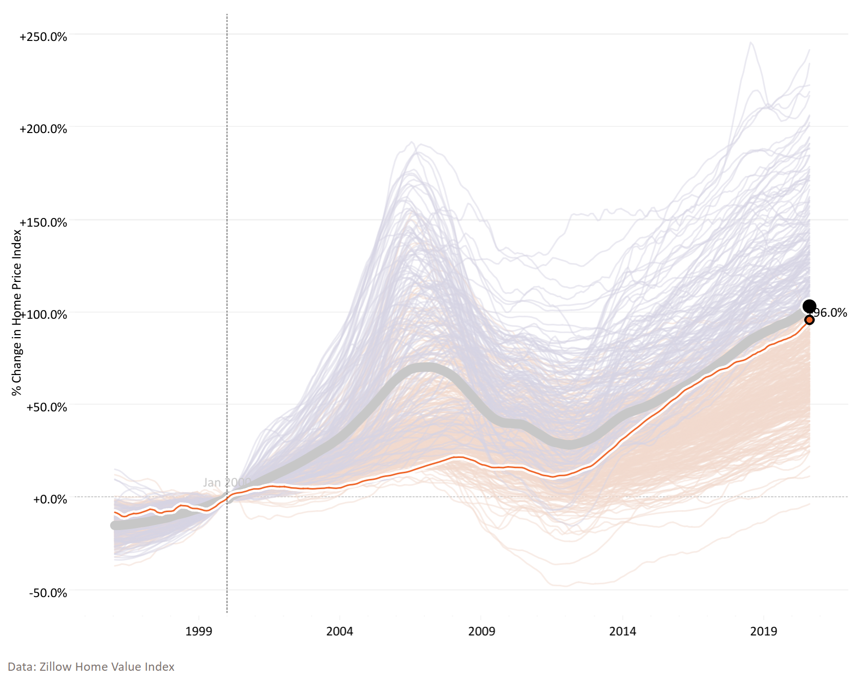
Austin Housing Market Statistics in 2020 Are Relatively Similar to the U.S. Average
Home Price Index Change Across U.S. Metro Areas: Jan 2000 – Aug 2020
 | Austin, TX | U.S. Avg.
Difference Jan 2000 – Aug 2020 | +96% | +103%
Home Price Index (Aug 2020) | $357k | $247k
U.S. Avg.
Austin, TX
Our dataset was scraped in Jan 2021
https://www.visualcapitalist.com/20-years-of-home-price-changes-in-every-u-s-city/

Slide 3
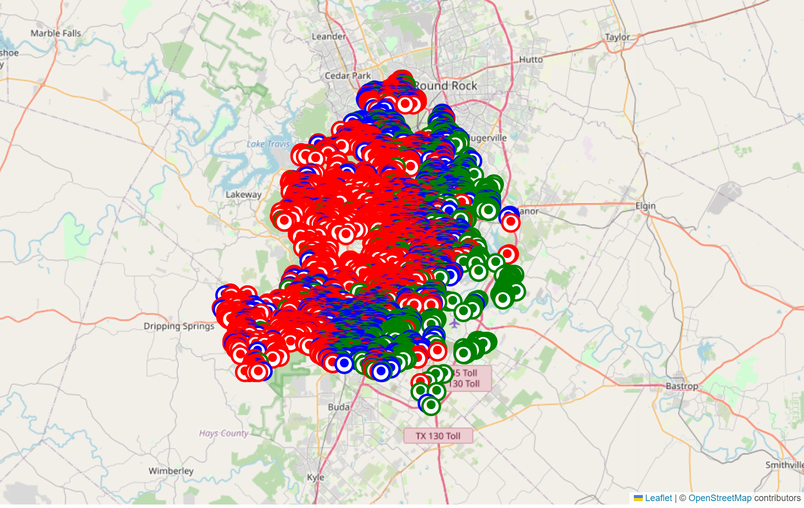
Housing Properties Clustered Around Austin Based on Their Price Bracket
12 MB
<$309k (1st Quartile)
<$405k (Median)
47 Features
>$405k
Austin
~15,000 Rows
Based on Zillow Listings
Targeting to Predict Housing Price column (“latestPrice”) – dependent variable

Slide 4

Lengthy Process of Optimizing Linear Regression Resulted in R² of ~30%
INDEPENDENT FEATURES COUNT
PROCESS DESCRIPTION
46
1
“description” column – processed using NLP
“city” and “homeType” columns → dummy variables
154
2
Sequentially dropped features with correlation >0.5
No multicollinearity identified
124
3
Dropped features that had p-values >0.05
Linear Regression
55
4
Initial
Linear Regression
55 features; large coefficients
Removed rows with outliers
Linear Regression
Dropped features that had p-values >0.05
28
5
Train Score: 31%
Test Score: 33%
Notes:
Also, dropped a few columns (such as Zillow identifier) that were not meaningful as first step
For CountVectorizer, used min_df=10, max_features=100

Slide 5
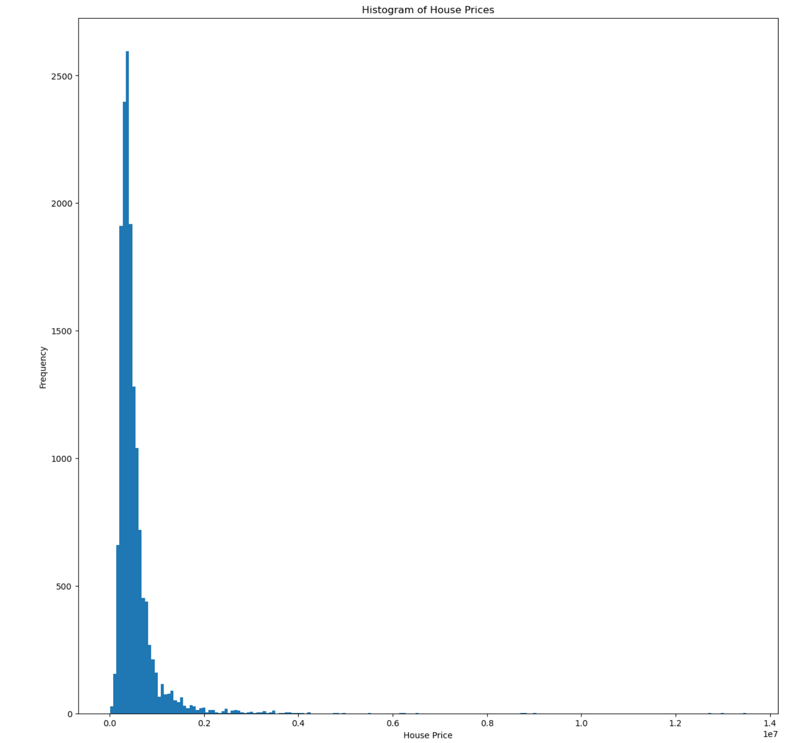
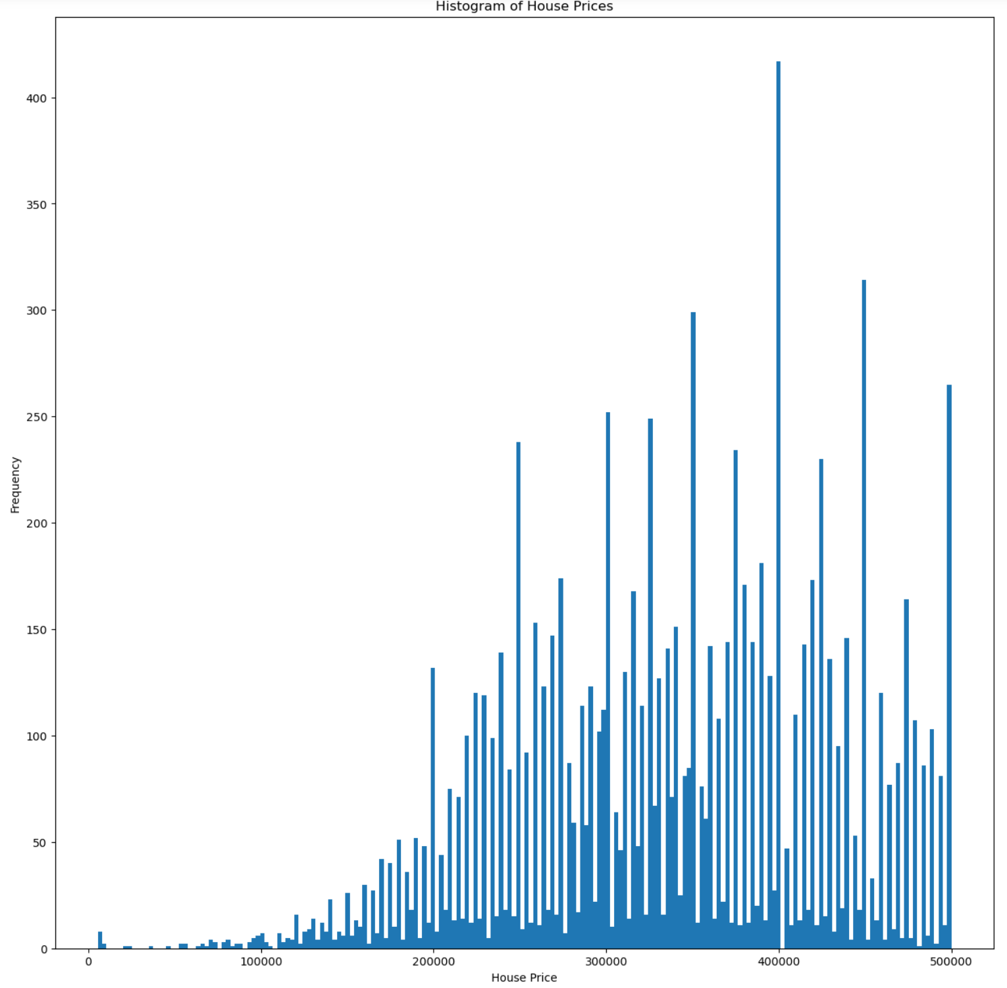
Removing Outliers Moved Test and Train Scores Closer Together and Adjusted Magnitudes of Linear Regression Coefficients
Removed outliers: where House Price > $500,000

Slide 6
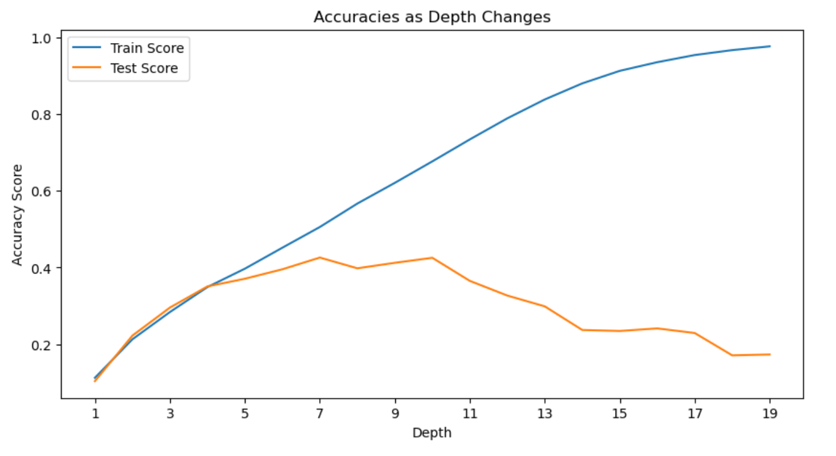
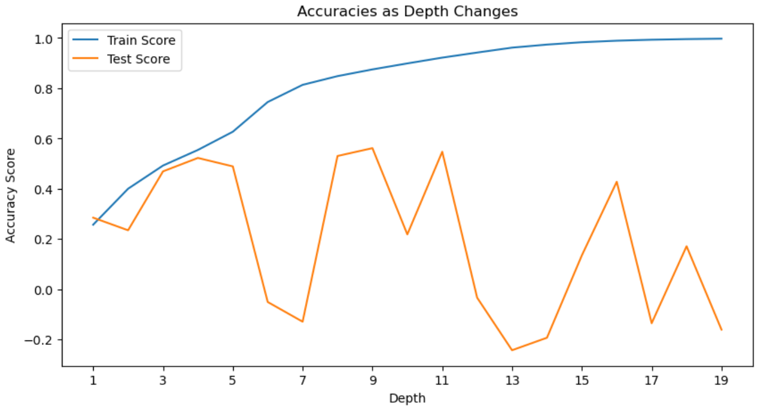
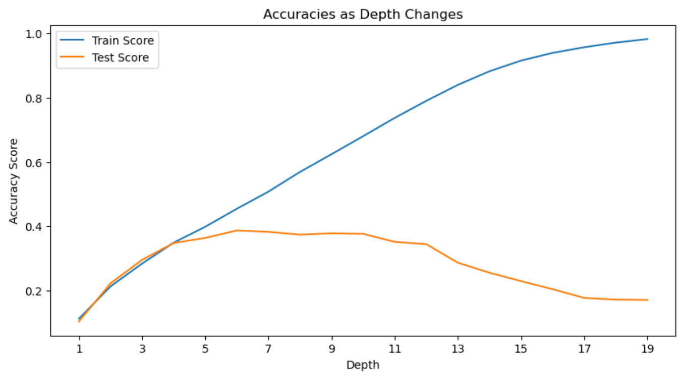
Decision Tree Regressor (with 4 Nodes) Provides 52% Accuracy in 2nd Scenario
28 Independent Features
Train Score: 35%
Test Score: 35%
124 Independent Features
Train Score: 55%
Test Score: 52%
124 Independent Features & Removed Outliers
Train Score: 35%
Test Score: 35%

